Slide 1

What Happened to Pharmaconutrition?
A (re-) emerging paradigm or
End of an era?
Daren K. Heyland
Professor of Medicine
Queens University, Kingston General Hospital
Kingston, ON Canada

Slide 2
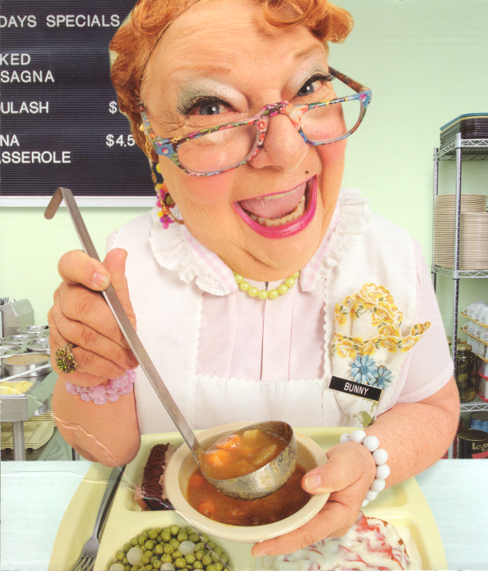
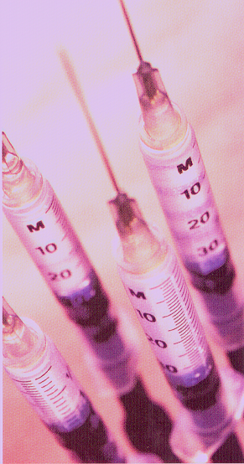

Pharmaconutrition
Nutrition therapy that modulates the underlying disease process and impacts outcome
Adjunctive
Supportive
Care
Proactive
Primary
Therapy
Circa Early 2000s
Notes:
Not talking about supplementation of physiological doses

Slide 3
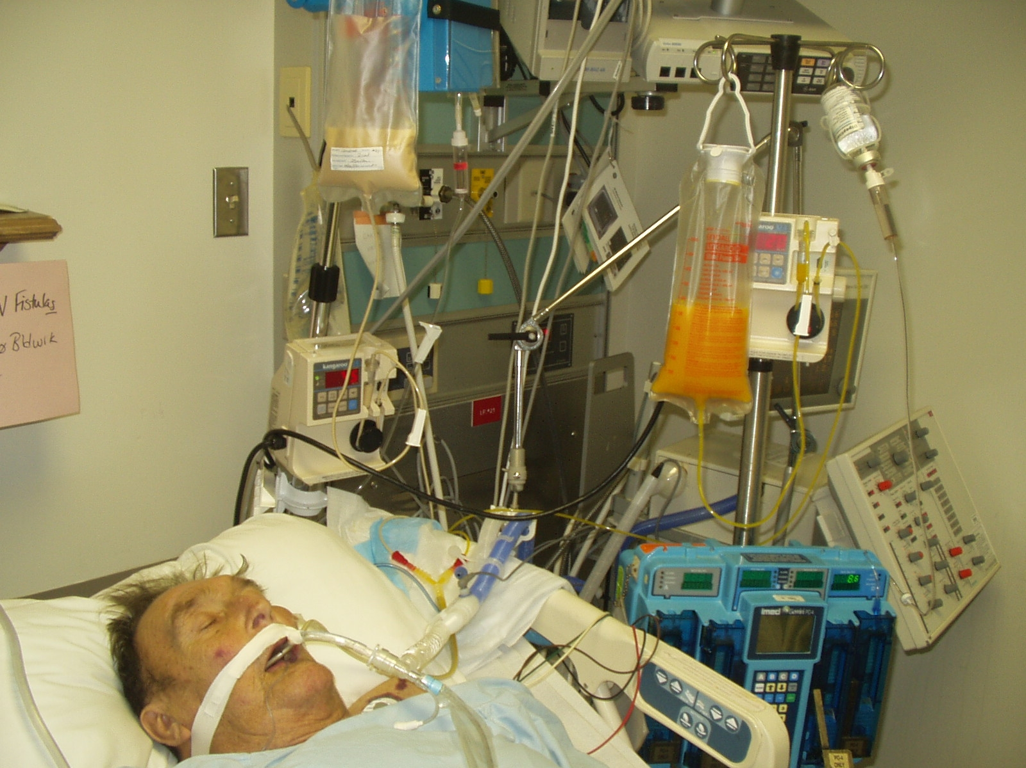

Slide 4

Pharmaconutrition:
End of an Era?
SCCM 2017

Slide 5
“We do not recommend…”
Arginine-containing diets
IV/EN glutamine supplementation
IV/PN selenium, alone or in combination with other antioxidants
IV/PN combined vitamins and trace elements
Fish oils
Notes:
Changed bullet 3 and 4

Slide 6
Large-scale Trials Have Failed to Demonstrate Any Positive Treatment Effect
REDOXS, Metaplus, SIGNET | Glutamine and Antioxidants
SISPCT | IV Selenium
Omega | Fish Oils
Meta-analysis of large scale RCTs | Arginine

Slide 7

Where do we go from here?

Slide 8
Outline
Must continue to be founded upon our (incomplete) understanding of underlying pathophysiology
Studied in homogeneous populations (compared to heterogeneous)
Informed by well-executed dose-finding studies
  ? Methods and outcomes
Focus on monotherapy vs. bundled therapy
Multicenter vs. single-centered

Slide 9
Move Towards Personalized Medicine …and away from large RCT’s of heterogeneous patients!
Sepsis and acute respiratory distress syndrome have manifestations that are physiologically and anatomically diffuse, and that fluctuate over short periods of time.
This leads to considerable heterogeneity among patients
“one size fits all” approach to therapy can lead to widely divergent and confusing results.
Current ICU therapy can thus be seen as imprecise, with the potential to realize substantial gains from the adoption of precision medicine approaches.
Maslove, Heyland Crit Care 2017

Slide 10

Move Towards Personalized Medicine …and away from large RCT’s of heterogeneous patients!
Degree of Personalization | Population | Treatment | Outcome
None
Sub-group
Sub-sub group
Individual
A or B
A or B
A or B
A or B
Negative
Negative?
More likely to be positive!
?
Intensive Care Med (2016)42:1781-1783

Slide 11
Glutamine:
A conditionally essential amino acid?
Glutamine levels drop:
- following extreme physical exercice
- after major surgery
- during critical illness
Low glutamine levels are associated with:
immune dysfunction
higer mortality in critically ill patients
Novak F, Heyland DK, A Avenell et al., Crit Care Med 2002
Oudemans-van Straaten HM, Bosman RJ, Treskes Met al., Intensive Car Med 2001

Slide 12
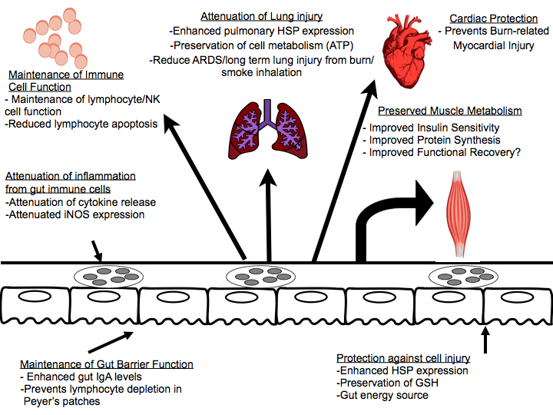
Putative Mechanisms of Glutamine Supplementation

Slide 13
Randomized >1200 critically ill patients with multi-organ failure
High dose of combined EN/IV doses
Demonstrated increased mortality overall
Subgroup analysis suggested this was in renal failure patients
Heyland N Engl J Med 2013;368:1489-97.

Slide 14
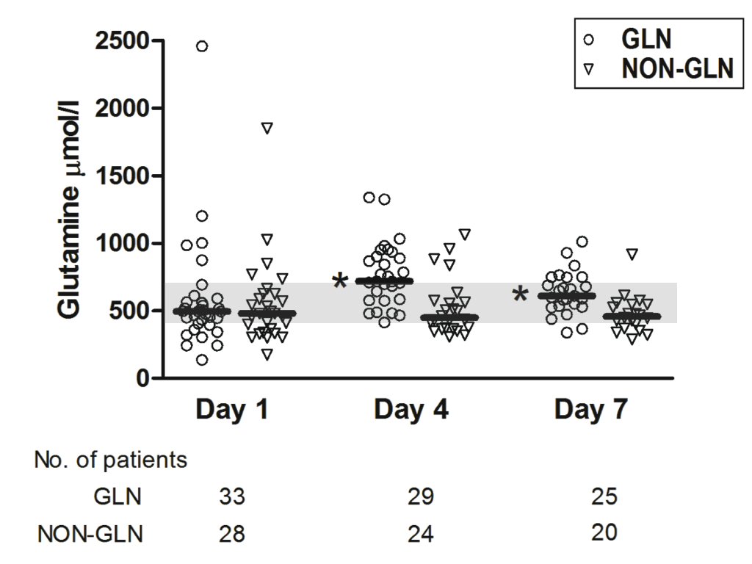
Plasma Levels of Glutamine in Subset of Patients from REDOXS Study
P <0.001
Heyland N Engl J Med 2013;368:1489-97.
Notes:
Baseline median plasma glutamine and selenium levels were within normal limits in all patients (Supplementary Figure 2 and Table S5). Glutamine supplementation led to a statistically significant increase in plasma glutamine at both day 4 and day 7 of ICU stay (P < 0.001) whereas antioxidant supplementation led to a significant increase in plasma selenium at day 4 and 7 of ICU stay (P < 0.001).

Slide 15
Glutamine and glutathione at ICU admission in relation to outcome
Rodas Clinical Science (2012) 122, 591–597

Slide 16
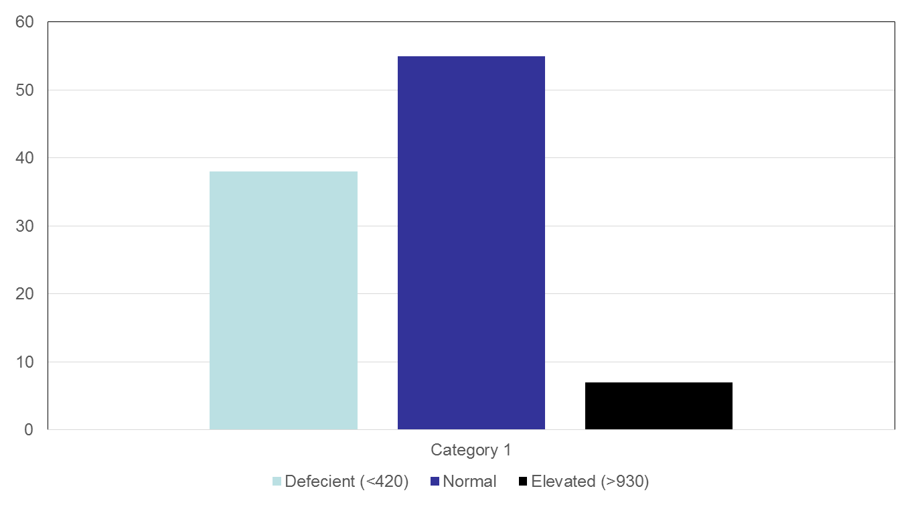

Slide 17
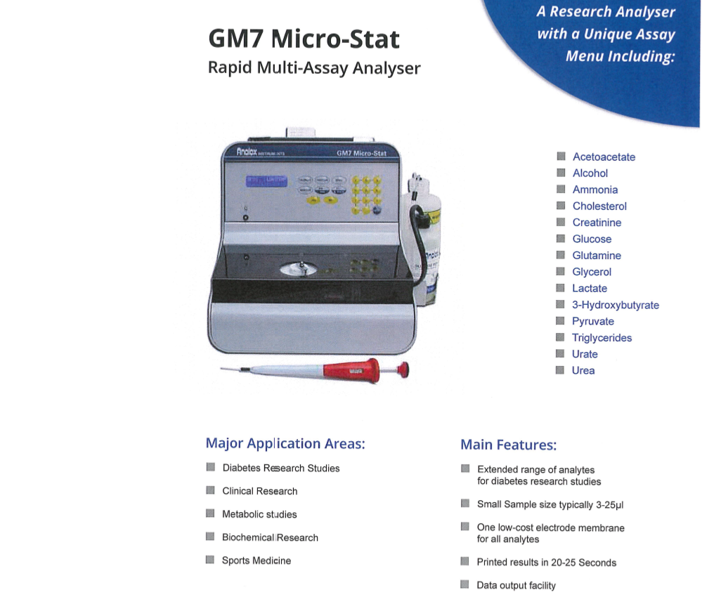
Future Trials Require Bedside Testing?

Slide 18
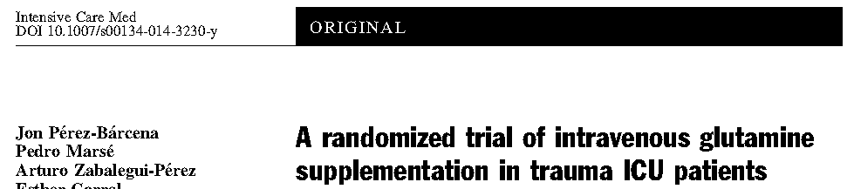
Double-blind, multicenter RCT
142 trauma patients (excluded renal failure)
0.5 gm/kg of Ala-Gln dipeptide x 5 days unrelated to PN vs. saline placebo (pharmaconutrition)
Overall, no effect on infection (primary endpoint), LOS, or mortality
No effect in subgroup that had low levels of GLN at baseline (n=60)
Of treated patients, 39% had low plasma levels at END of treatment – day 6 levels associated with worse outcomes

Slide 19
Updated Meta-analysis of IV Glutamine
Influence of the number of study sites involved in the trial
Hospital Mortality
www.criticalcarenutrition.com
Notes:
Need to update this slide and show arg related studies in same fashion as well.

Slide 20
Many positive single-center trials have been contradicted when tested in other settings and, in one case, the subsequent definitive multicentered trial has found a previously recommended intervention associated with active harm.
Problems inherent in the nature of single-center studies make recommendations based on their results ill advised.
Single-center studies frequently either lack the scientific rigor or external validity required to support widespread changes in practice, and their premature incorporation into guidelines may make the conduct of definitive studies more difficult.
They recommend that practice guidelines should rarely, if ever, be based on evidence from single-center trials.
Crit Care Med 2009; 37:3114 –3119

Slide 21
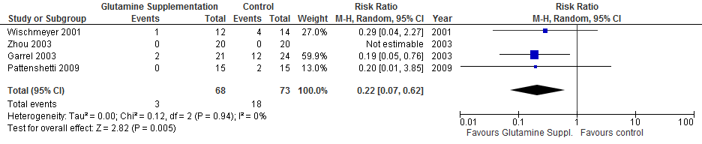
The existing data in burn-injured patients is positive…
Effect on Mortality (n=4)
RR, 0.22, 95% CI 0.07, 0.62, p = 0.005
…But the existing data set is small and from single centered studies (unreliable estimate). Therefore, we need a larger, multicenter trial!

Slide 22
Plasma Glutamine Levels in Burn-injured Patients
24 Health Patients (control)
Parry-Billings Lancet 1990

Slide 23
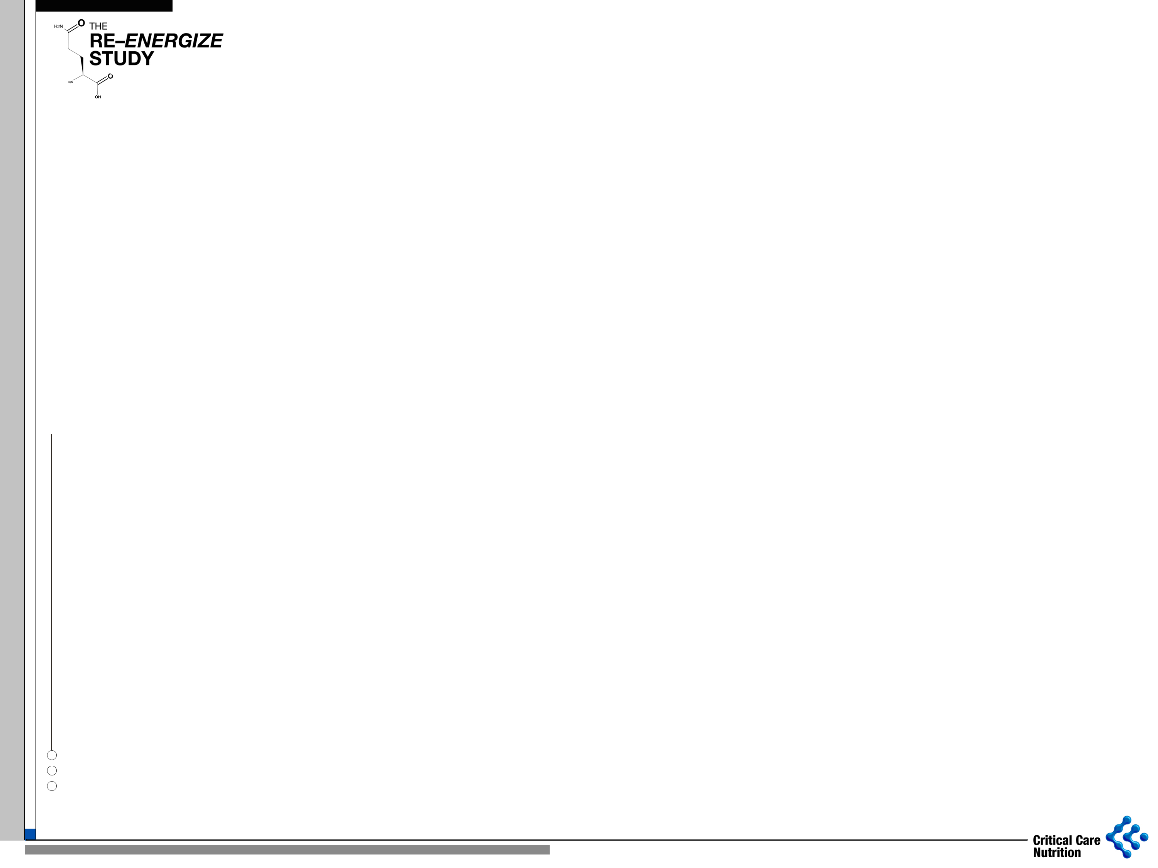
A RandomizEd Trial of ENtERal Glutamine to MinimIZE Thermal Injury:
Double blind treatment
EN glutamine
1200 patients with TBSA
≥ 20% if 18-39 yrs age
≥ 15% if 18-39 yrs age
with inhalation injury
≥ 15% if 40-59 yrs age
≥ 10% if ≥ 60 yrs age
R
Concealed
Stratified by site
6 month mortality
Maltodextran
placebo
785 enrolled to date!
Notes:
Update enrollment

Slide 24
Rationale for Antioxidants
Infection
Inflammation
Ischemia
OFR
CONSUMPTION
OFR
PRODUCTION
Depletion of
Antioxidant Enzymes
OFR Scavengers
Vitamins/Cofactors
Impaired
- organ function
- immune function
- mucosal barrier function
OFR production > OFR consumption =
OXIDATIVE
STRESS
Complications and Death

Slide 25
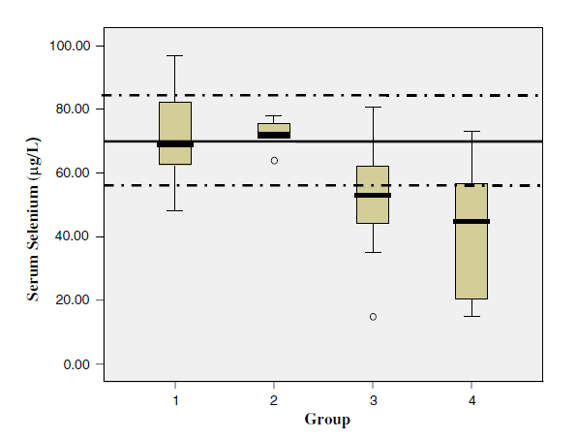
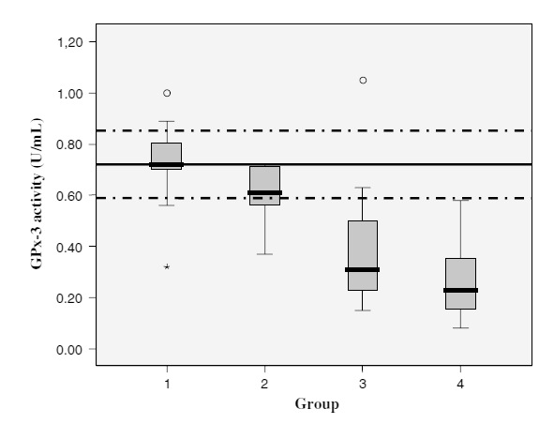
Selenium in Critical Illness
Circulating serum levels
Glutathionperoxidase (GPx) activity
p= .002
p= .0001
p= .0001
p= .0001
p= .032
p= .0147
p= .0001
GPx activity
GPx-3 activity (U/mL)
Serum selenium (μg/L)
HV Non SIRS SIRS SIRS-MODS
HVS Non SIRS SIRS SIRS-MODS
HV=healthy volunteers
Manzanares W, et al. Intensive Care Med 2009; 32:882-889.

Slide 26
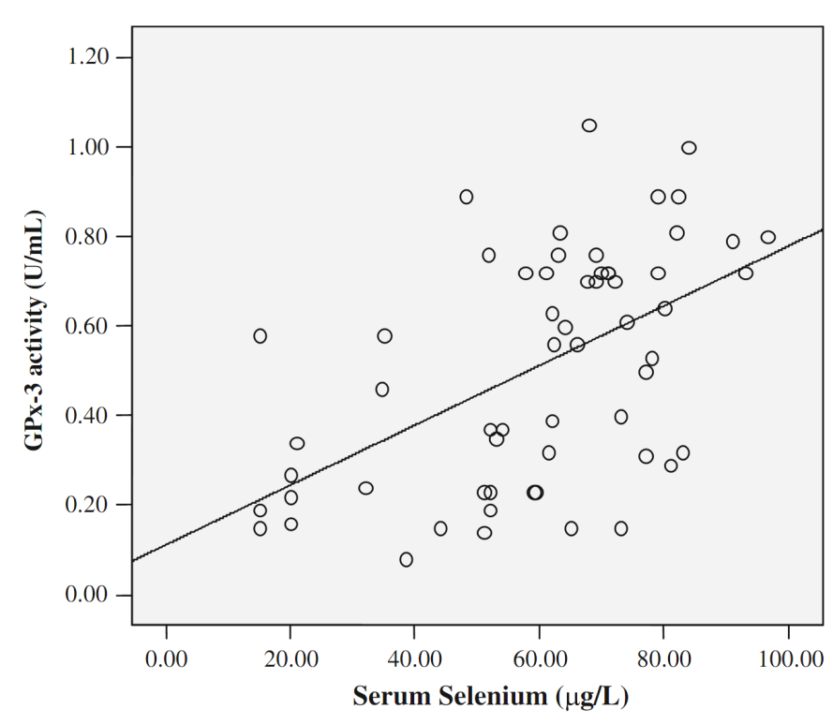
Selenium in Critical Illness
Correlation of selenium levels and GPx activity
Low plasma selenium levels result in suboptimal AOX-enzyme activities!
Manzanares W. et al.
Intensive Care Med (2009) 35:882–889

Slide 27
The SISPCT study
Selenium
N= 273
PCT
guidance
R
1180 ICU patients
R
R
Evidence of
Factorial 2x2 design
Placebo
N= 279
severe sepsis
Selenium
N= 270
No PCT
guidance
R
Placebo
N= 267
Bloos F, et al. JAMA Internal Medicine 2016

Slide 28
PLASMA SELENIUM
Bloos F, et al. JAMA Intern Med 2016

Slide 29
Survival Curves: Placebo versus Selenium
Bloos F, et al. JAMA Internal Medicine 2016.

Slide 30
Is sepsis too heterogeneous of a disease to manifest a positive treatment effect?

Slide 31

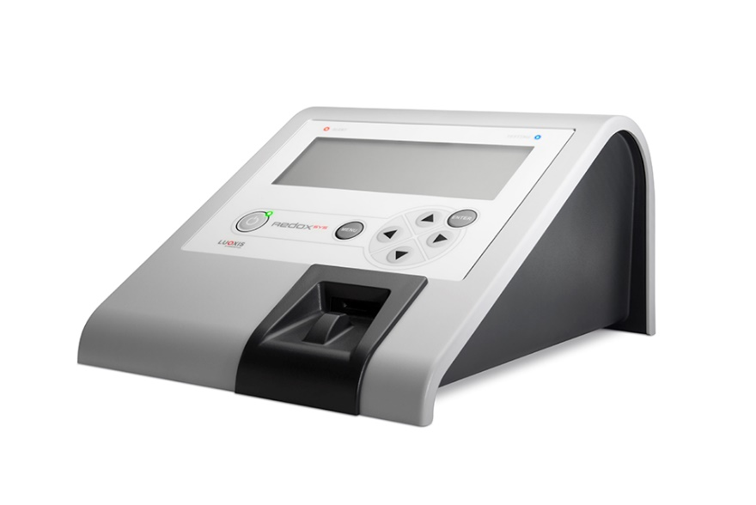
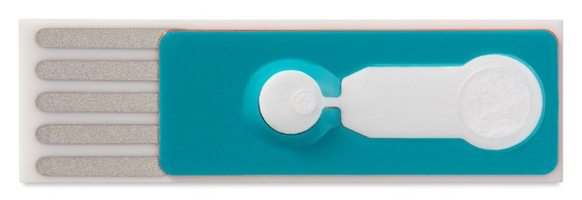
Markers to quantify Oxidative stress oxidation-reduction potential (ORP)
Specific technical measures reported by the RedoxSYS™™ System include:
  Static ORP –The tendency of a system to either donate or take up electrons with no applied perturbations (current) – (mV) an aggregate measure of oxidative stress
  Capacity – the measure of antioxidant reserve in the biologic system (µC)
  Antioxidant bulk concentration – concentration of antioxidants in the biologic system (mmol)
The RedoxSYS bench top reader is a small, portable console.
The RedoxSYS sensors are disposable and are approximately the size of glucose test strips.

Slide 32
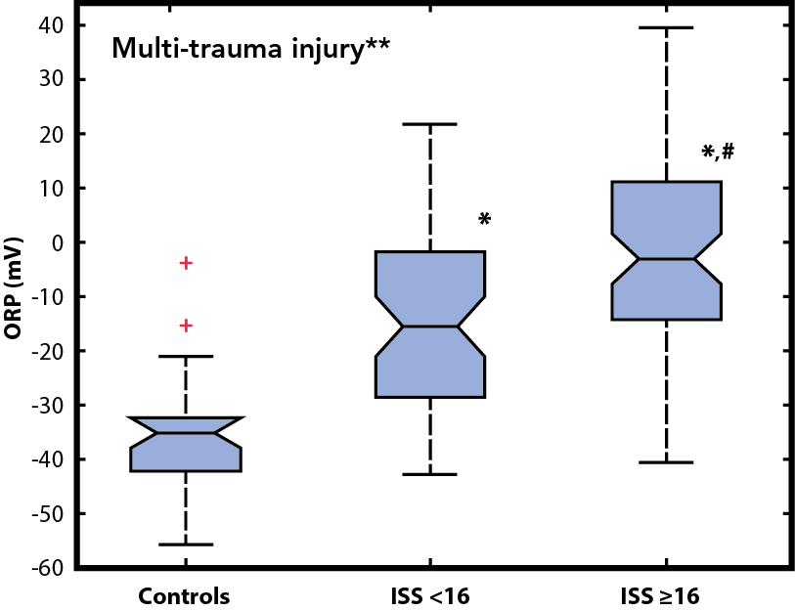
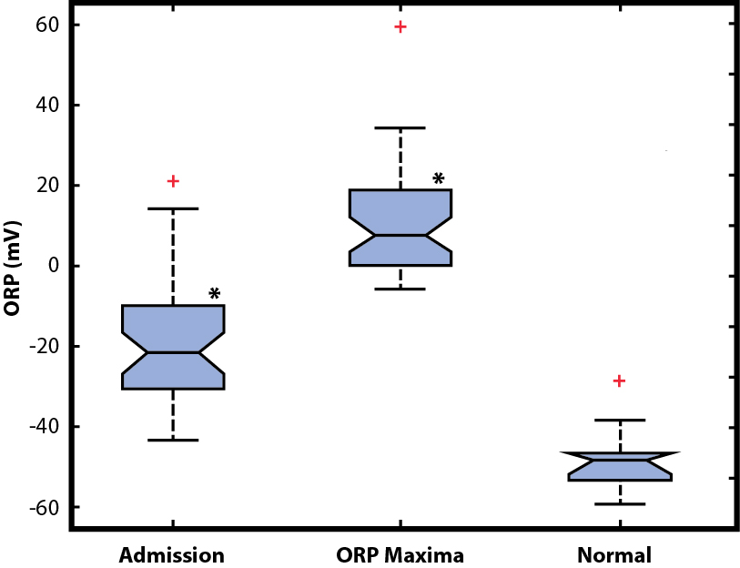
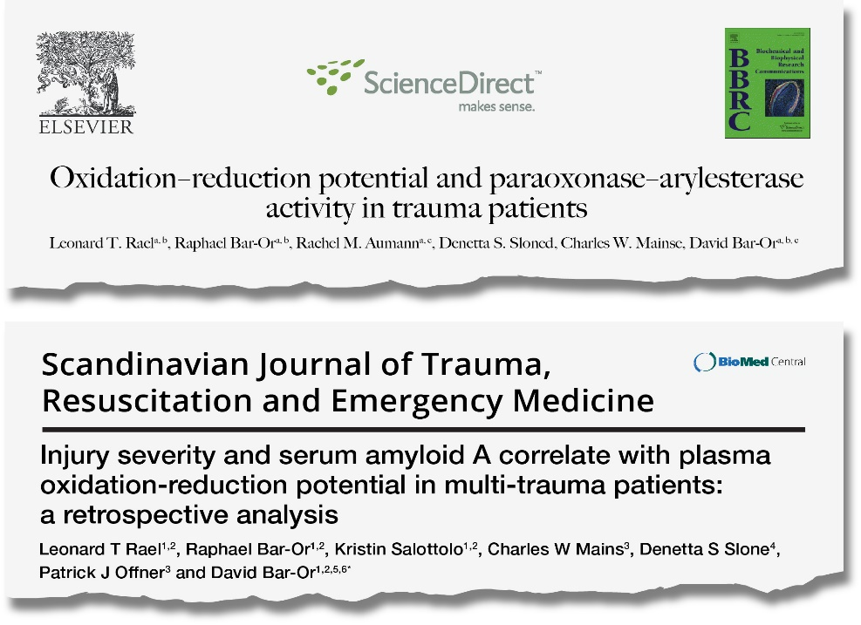
Clinical evidence: Multi-Trauma
Findings:
ORP differentiated the degree of oxidative stress based on the severity of the trauma
Plasma ORP in multi-trauma patients increased during the first few days of hospitalization and approached normal ORP levels upon discharge
Retrospective study #1 (N=49)
    Severe trauma
    Healthy volunteers
Retrospective study #2 (N=140)
    Mild-to-moderate trauma
    Severe trauma
    Healthy volunteers

Slide 33
Can we use a bedside test to better identify patients with greater oxidative stress (sub-set of patients who will benefit the most from pharmaconutrition)?

Slide 34
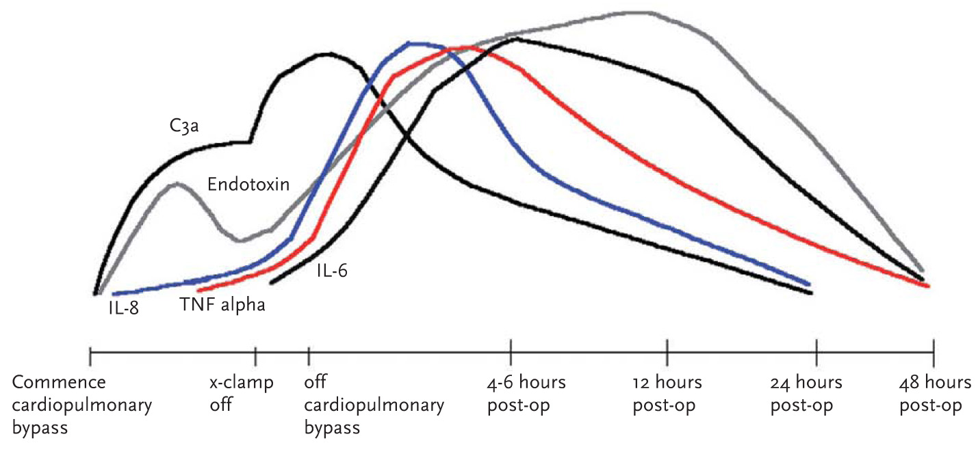
Why Cardiac Surgery as a Model for a Trial of Pharmaconutrition?
Scheduled insult
Mortality & Morbidity relatively common
Morbidity often involves multiple organs = systemic process
Large body of evidence implicating excessive systemic inflammation

Slide 35
The Systemic Inflammatory Response In Cardiac Surgery
Treatment Approaches
Block or reduce stimulus
E.g., Coated Circuits, SDD, Pulsatile Perfusion, Leukofiltration, Cardioplegia, Oxygenator Off-pump Surgery, Cardiotomy Suction, Limitations to transfusion, Cell Washing
Block Cellular Activation
E.g., Agents directed at blocking Adhesion Molecules or Integrins, Open Lung Mechanical Ventilation
Block Signaling Mechanisms
E.g., Insulin, Pentoxyfylline, Glucocorticoids, Serine Protease Inhibitors, Statins, Phosphodiesterase Inhibitors, Eritoran
Antimediator Therapies
E.g., Anti-Complement Strategies, Monoclonal Antibodies, Receptor Blocking Agents
Block or Reduce Free Radical Production
E.g., NAC, Methylene Blue
Use of Life-Sustaining Treatments
Stimulus
Hypoxia/Ischemia/Reperfusion/Endotoxin
Contact Activation with Components of the CPB Circuit
Surgical Tissue Trauma
Cellular Activation
Lymphocytes
Monocytes
Macrophages
Endothelial Cells
Epithelial Cells
Alteration in intracellualar Signaling Mechanisms
Activation of NFκB
Release of Adhesion Molecules and Integrins
Release of Inflamatory and Anti-inflamatory Mediators
IL-6 IL-8 IL-10
TNFα Complement PAI-1
SELENIUM
Microcirculatory
Coagulopathy
Generation of Free Radicals
Apoptosis
Organ Dysfunctions & Acute Multiorgan Failure
Persistent Organ Dysfunction and Death

Slide 36
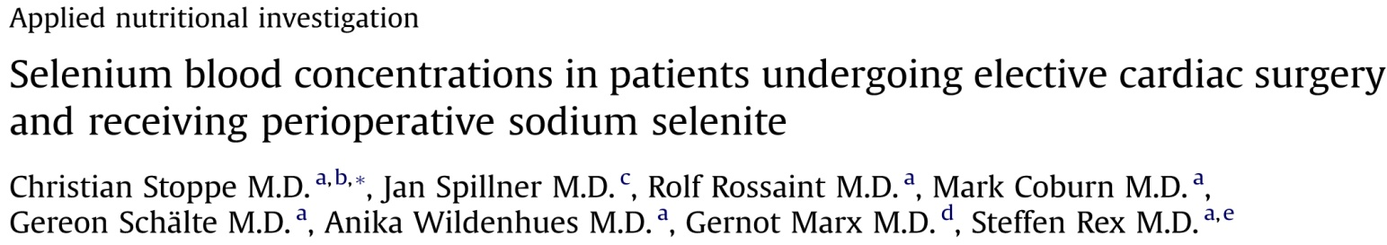
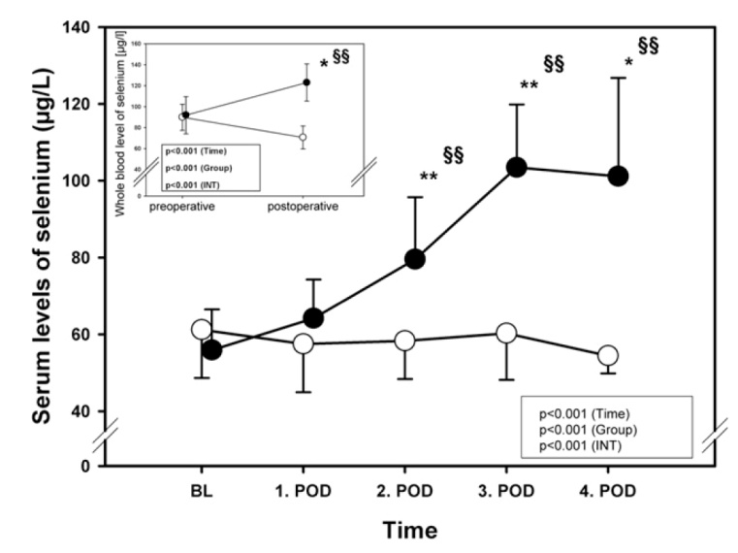
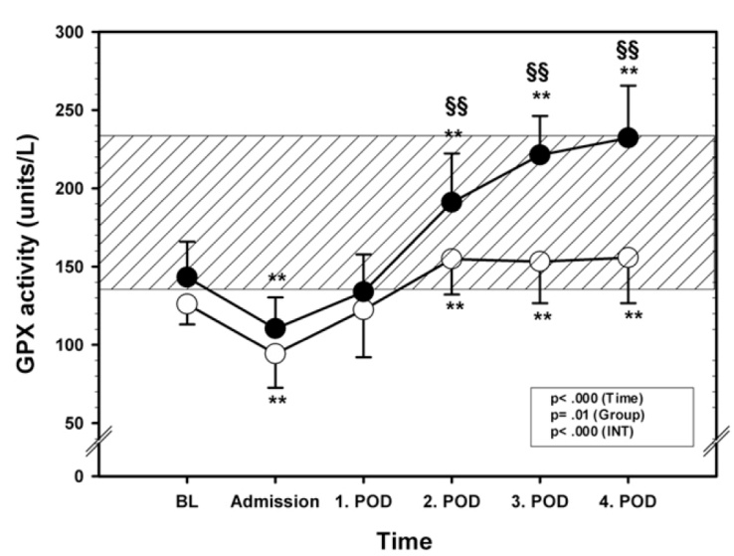
Nutrition 29 (2013) : 158-165

Slide 37

SodiUm SeleniTe Adminstration IN Cardiac Surgery (SUSTAIN CSX®-trial)
Double blind treatment
IV Selenium
Alive and free of POD
Or Time to freedom from life-sustain treatments
1400 high-risk
patients undergoing
cardiac surgery
R
Concealed
Stratified by site
placebo
1045 enrolled to date!

Slide 38
Vitamin D in Cardiac Surgery?
Fig. Perioperative VITD levels
1,25(OH)₂D levels decreased significantly, while serum levels of 25OHD did not..
Higher levels of 1,25(OH)₂D were associated with i.) significantly less postoperative organ dysfunctions ii.) lower PCT levels & iii.) reduced hospital stay
Ney, Stoppe et al. Clin Nutrition 2018

Slide 39
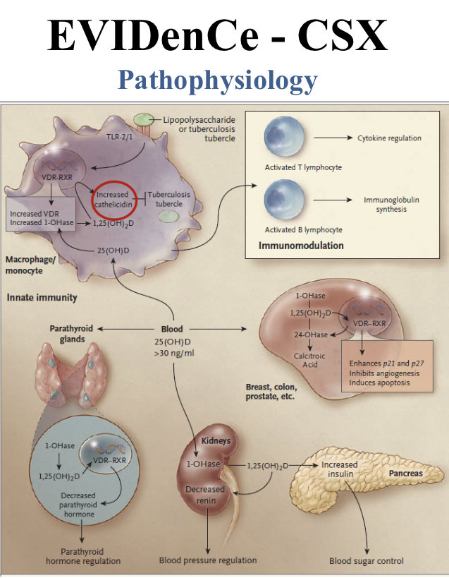
Notes:
Sldie from Julia re rationle why vit d might be effective?

Slide 40
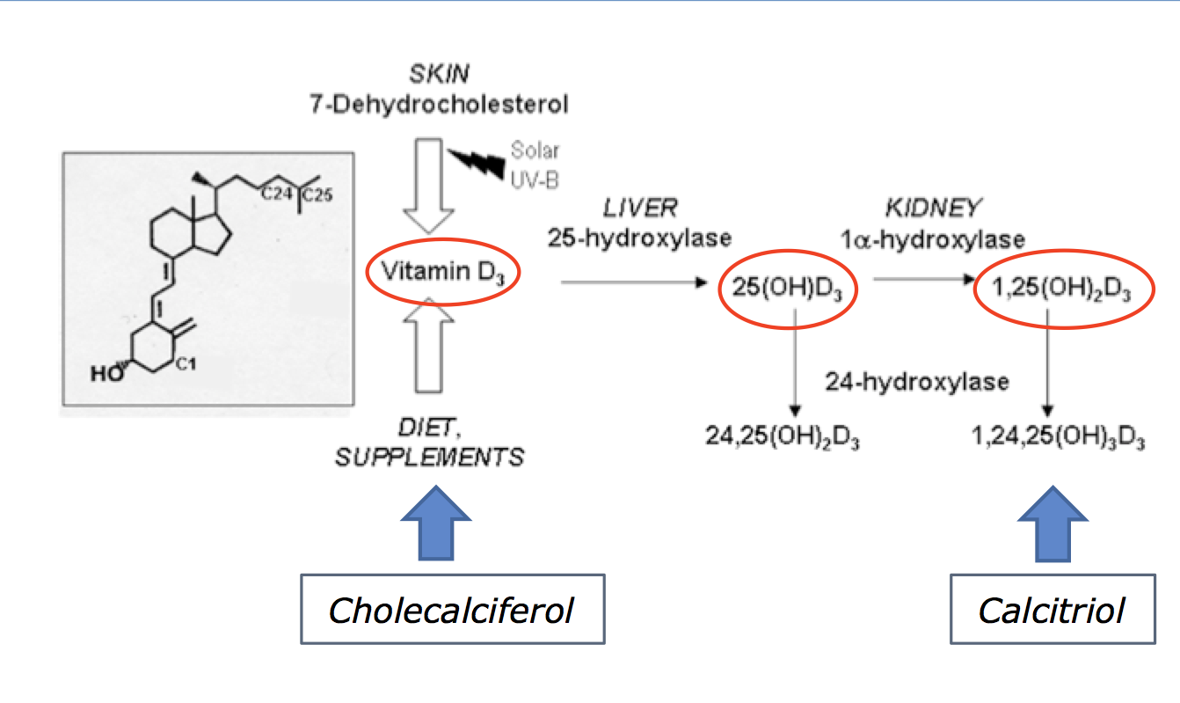

Study hypothesis
Previous studies failed to demonstrate an overall beneficial effect ..(1) or were stopped early due to futility…(2)
Therefore we propose an alterative strategy….
Innovative approach:
The combined parenteral administration of biological active and inactive VITD may enable a faster mode of action …
Fig. Biological metabolism of VITAMIN D
Amrein K et al JAMA 2014 2. Thompson et al. VIOLET Trial NCT03096314

Slide 41
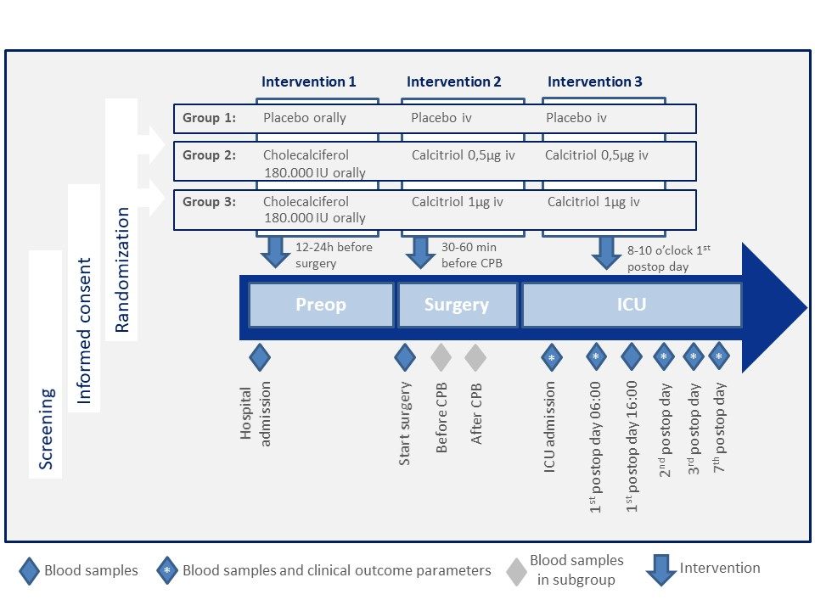
Methodology and course of the study

Slide 42
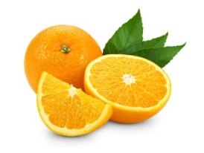
High Dose Vitamin C Supplementation?
Vitamin C
  potent antioxidant
  support endothelium reducing permeability and microvascular dysfunction
  Co-factor in synthesis of catecholamines
  Promotes wound healing
  Multiple effects on immunity

Slide 43
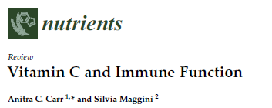
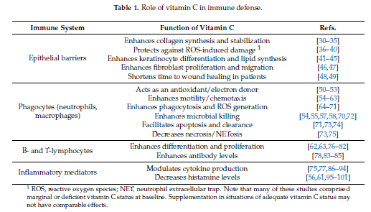

Slide 44
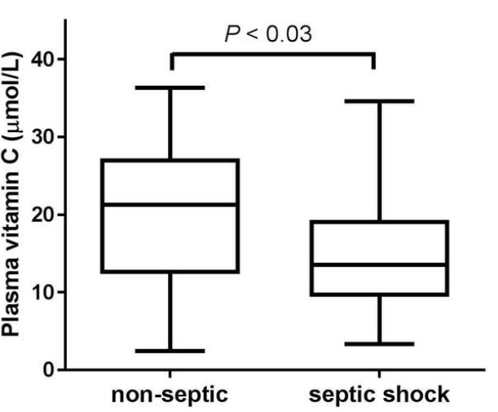
Needs are acutely increased
  possible mechanisms
    poor intake
    underlying disease
    redistribution into cells
    consumption ↑
    recycling ↓
    renal loss ↓ (glomerular hyperfiltration)
Carr Crit Care 2017

Slide 45
Phase I Vit C dosing study in Sepsis
Placebo
Plasma levels
SOFA
Other biomarkers
R
31 septic patients
Low dose (50 mg/kg/day)
High dose (200mg/kg/day)
Fowler et al. J Translational Medicine 2014;12:32

Slide 46
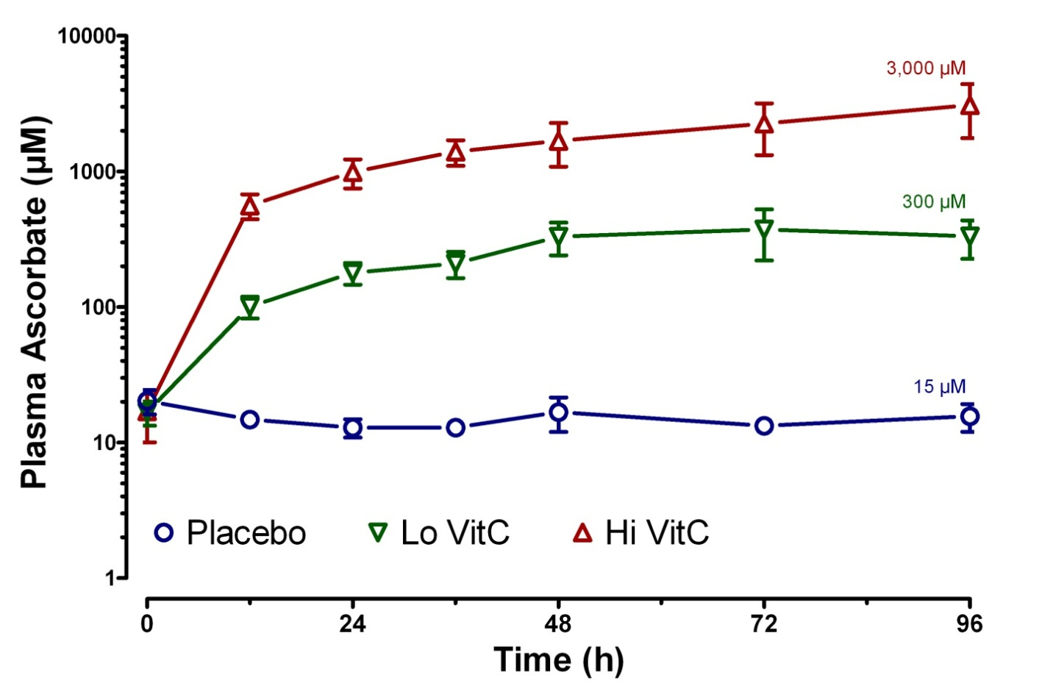
Plasma Vitamin C Levels
Fowler et al. J Translational Medicine 2014;12:32

Slide 47
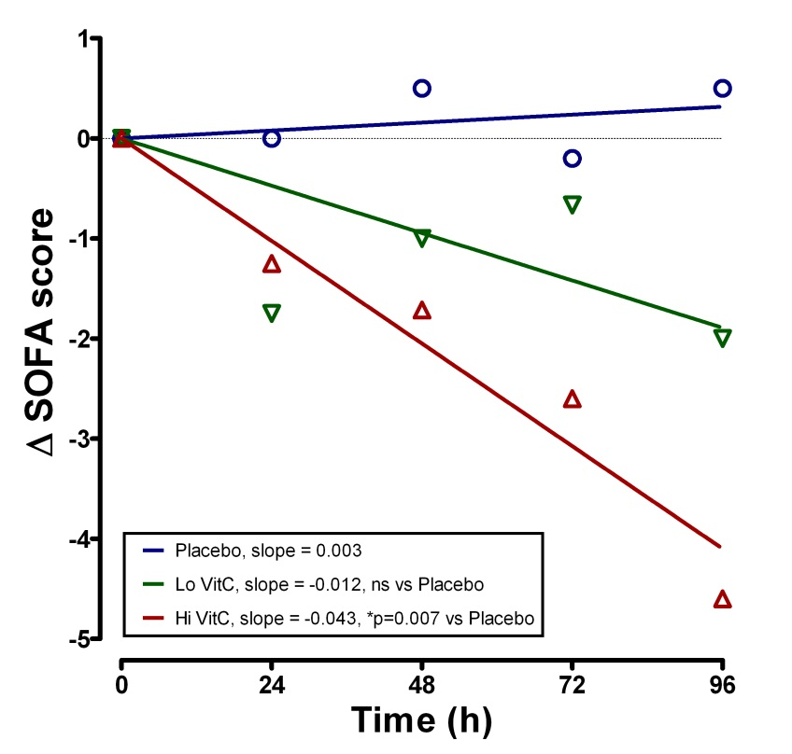
EFFECT on Organ Failure and other Mechanistic Endpoints
+ Reduced CRP and PCT (markers of inflammation)
+ Reduced Thrombomodulin (marker of vascular injury)
Await results of Phase II trial!
Fowler et al. J Translational Medicine 2014;12:32

Slide 48
Hydrocortisone, Vitamin C and Thiamine for the Treatment of Severe Sepsis and Septic Shock:
A Retrospective Before-After Single Center Study
Cocktail of Hydrocortisone 50 mg q 6h x 7 days, IV Ascorbic Acid 1.5 grams q 6h, and Thiamine 200 mg q 12h x 4 days
Marik Chest 2017

Slide 49

Immunonutrition:
In Search for the Best Cocktail
Arginine
Glutamine
Omega-3 fatty acids
Nucleotides

Slide 50
Test Monotherapy, Not Combination therapy?
Systematic review of Vit C supplementation
Langlois JPEN 2018

Slide 51
Single-center RCT of 28 patients
Treated patients received 25 mg/kg intravenous ascorbic acid every 6 h for 72 h.
Zabet J Res Pharm Pract 2016;5:94-100.

Slide 52
Double blind treatment
IV Vit C (200mcg/kg/day in divided doses)
750 ICU patients with sepsis and vasopressors
R
Concealed
Stratified by site
28-day Persistent Organ Dysfunction (POD)+death*
Saline
placebo
*Heyland Crit Care 2011

Slide 53

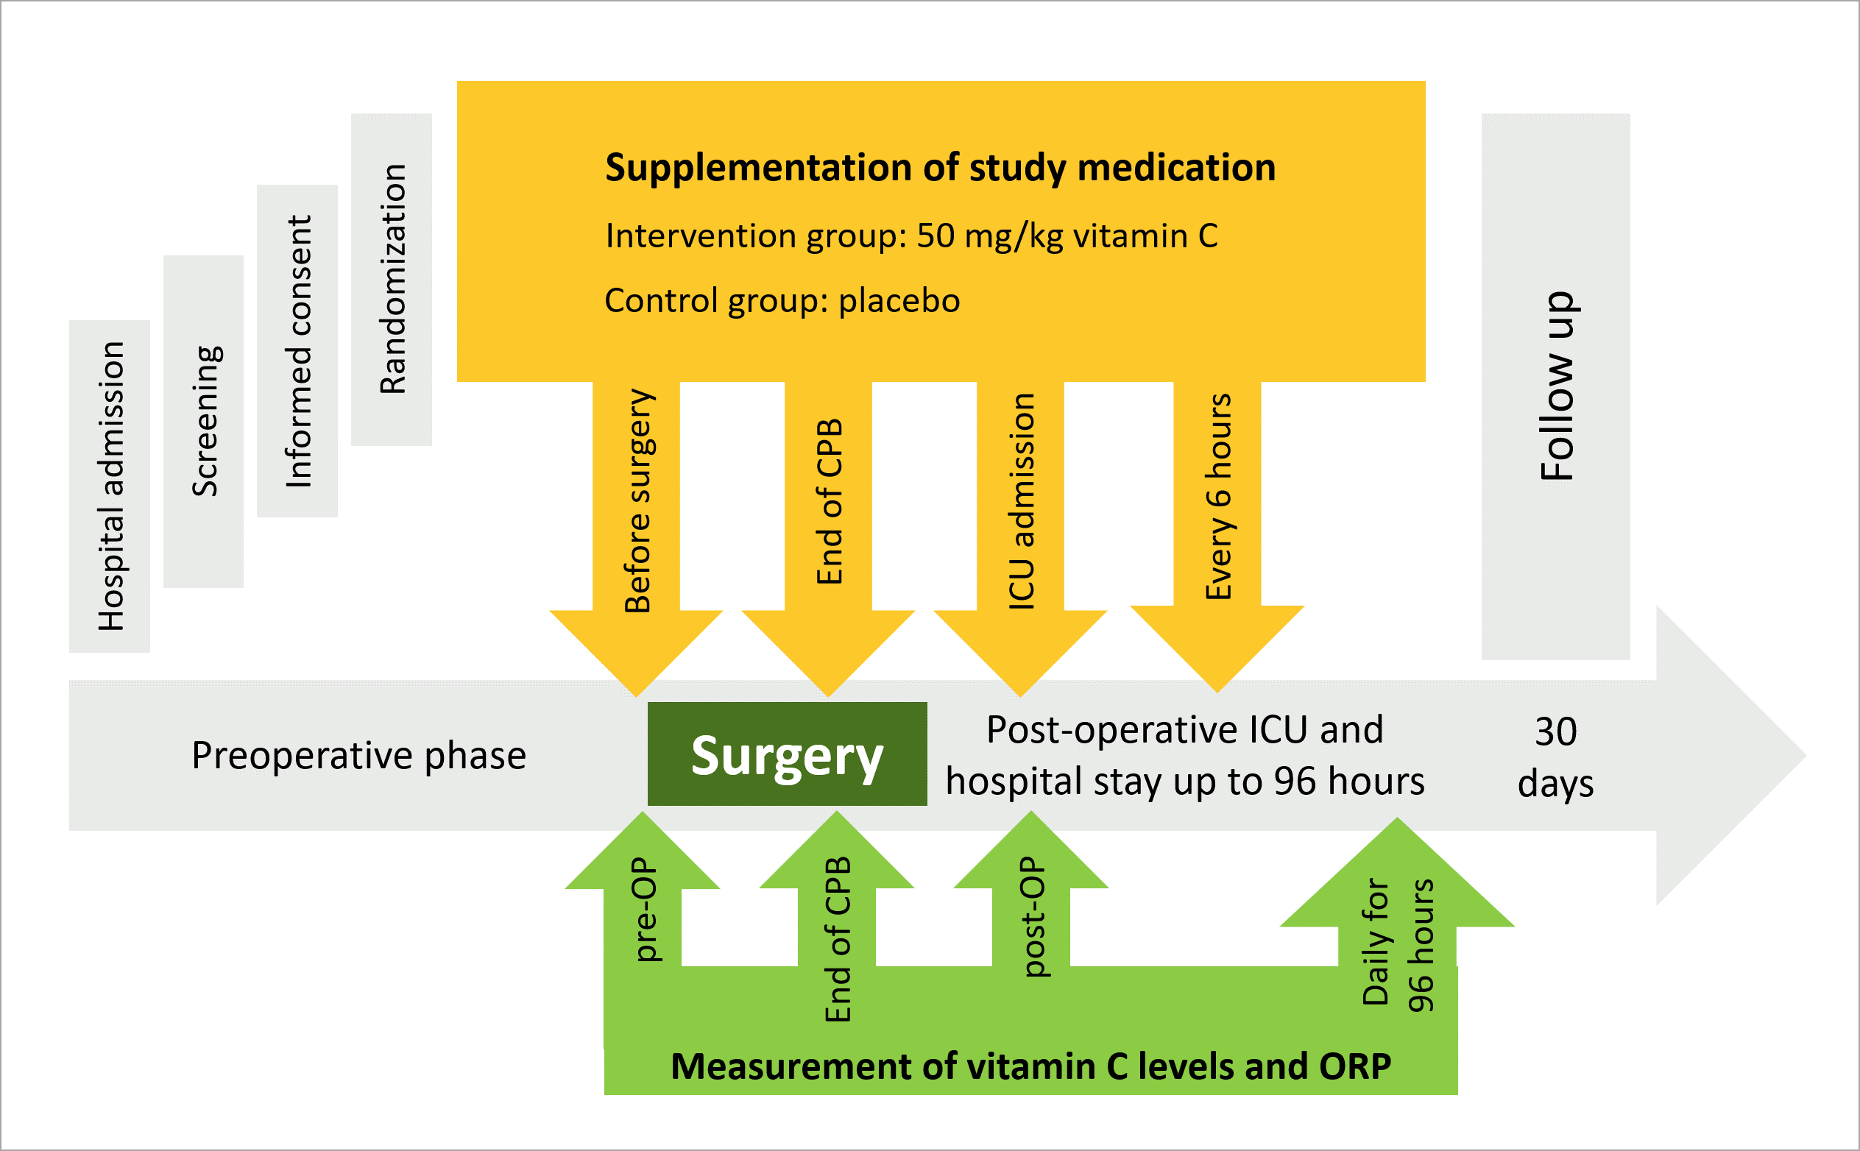

-Antioxidant Treatment with Vitamin C
ADVANCE-CSX

Slide 54
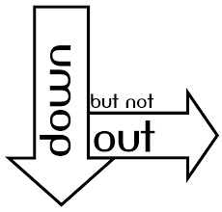
Pharmaconutrition:
End of an Era?
There may be a future for Glutamine in Burns and Selenium and Vit C, D
in Cardiac Surgery
Vit C in Sepsis
General Use of glutamine, Se, Arg, EN Fish Oils in the ICU

Slide 55
The Paradigm Continues!
Must continue to be founded upon our (incomplete) understanding of underlying pathophysiology
Studied in homogeneous populations (compared to heterogeneous)
Informed by well-executed dose-finding studies
  ? Methods and outcomes
Focus on monotherapy vs. bundled therapy
Multicenter vs. single-centered

Slide 56
Questions?

